Slide 1
Group Role Assignment with Conflicting Agents on Roles
Lab 3 | Qian Jiang
MUST | F.I.E

Slide 2
Content
Preliminary Knowledge
Objectives
Assignment
Turn in Requirement
Notes:
This lab lesson is divided into four parts. First, we will introduce some preliminary knowledge about Group Role Assignment with conflicting agents on roles or the relevant programming information to solve this model. Next, we will talk about the objectives for this lesson. Then, we will talk about the assignment for this lesson and its requirement. (Next slide)

Slide 3
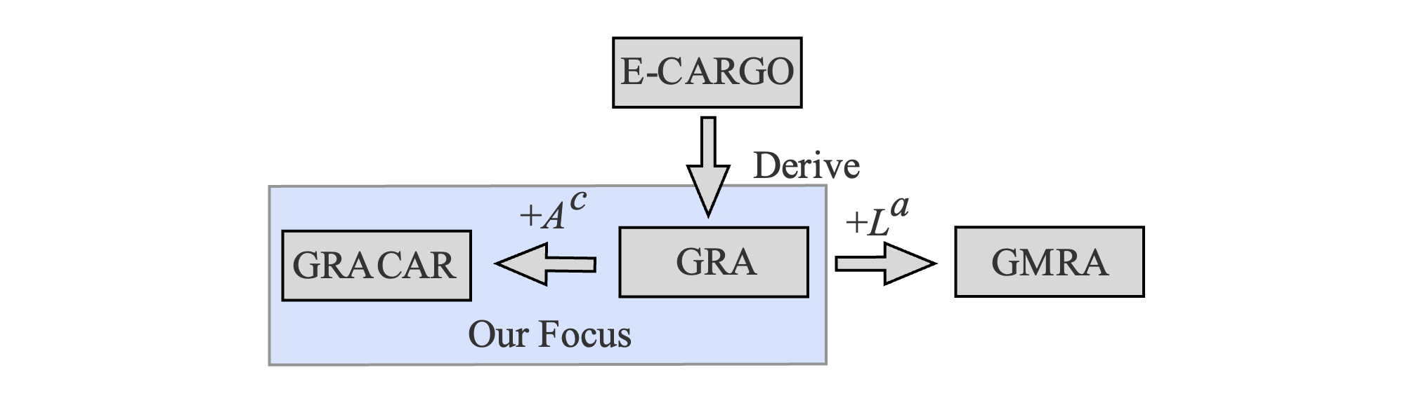
Preliminary Knowledge-Preview
Group Role Assignment with Confict Agents on Roles (GRACAR) is derived from the Group Role Assignment (GRA) submodel.
Compared to the GRA model, the GRACAR model extends the applicable scenarios compared with the GRA model. The GRA model assumes that there is no conflict between agents when performing the same role.
The GRACAR model takes into account the conflicted relationship between agents and introduces the agent conflict matrix A^{c} to formalize the conflicted relationship between agents.
Development of the GRACAR model
The GRACAR model is also derived from the GRA model.
Notes:
Group Role Assignment with Confict Agents on Roles (GRACAR) is derived from the Group Role Assignment (GRA) submodel. Compared to the GRA model, the GRACAR model extends the applicable scenarios compared with the GRA model. The GRA model assumes that there is no conflict between agents when performing the same role. On the other hand, the GRACAR model takes into account the conflicted relationship between agents and introduces the agent conflict matrix A^{c} to formalize the conflicted relationship between agents. It illustrates the relationship between the E-CARGO-related models mentioned so far. It is an efficient tool to solve 1-M (one-to-many) assignment problems with existing conflicted relationships between task executors when performing tasks.

Slide 4
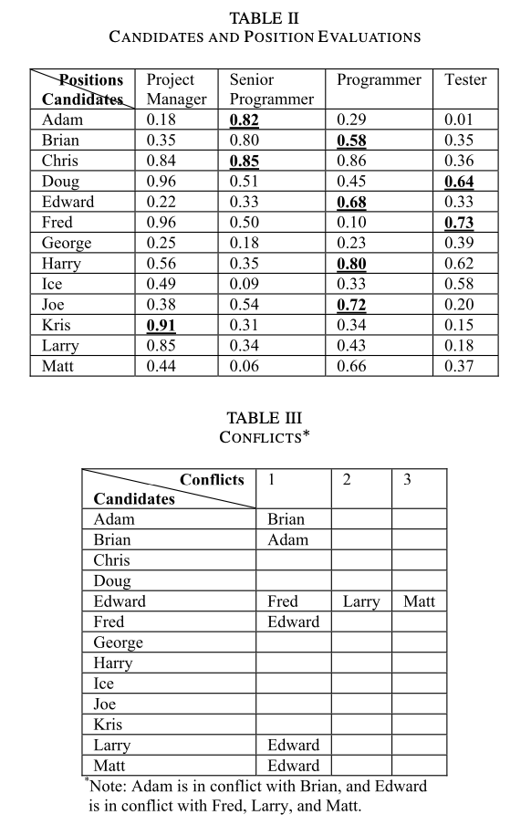
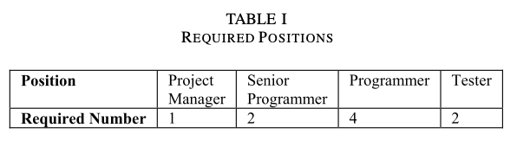
Preliminary Knowledge-A Real-world Scenario
Decision-makers of company X decides to organize a team from employees with the budget of one million dollars.
From historical experiences, employee conflicts arise for various reasons, such as personality characteristics, working styles, emotional issues, and political beliefs (see Table III).
Goal: Help decision-makers build the most suitable team after considering conflicts among employees.
Notes:
In company X, Ann, the Chief Executive Officer, has just signed a contract, the value of which is a million dollars. She asks Bob, the Human Resources Officer, to organize a team from employees of the company. Bob drafts a position list shown in Table I for the team and a candidate staff shortlist shown in Table II. Then, Bob initiates an evaluation process and asks the branch officers to evaluate employees for each possible position (Table II). After that, when Ann and Bob have a meeting with the branch officers to assign positions to candidate employees, the officers report that from historical experiences, employee conflicts arise for various reasons, such as personality characteristics, working styles, emotional issues, and political beliefs (Table III). That is to say, when constructing an agile group in a single office, performance cannot be compromised due to employee conflicts. Ann instructs Bob to assign the most qualified candidates to positions while avoiding employee conflicts. After some consideration, Bob suggests that a satisfactory solution, in light of such a challenge, may require a significant amount of time. Fortunately, Ann, as an experienced administrator, understands the complexity of the problem and does not demand an unreasonable response timeframe.

Slide 5
Preliminary Knowledge-GRACAR Model
∑ ::= <C, O, A, M, R, E, G, s₀, H>
Environments
Classes
Agents
Roles
Groups
Objects
Object-based
Agent-based
Development of the GRACAR model
Role-based
Roles (Tasks): Required Positions Agents (Executors): Employees
Notes:
Based on the real-world scenario of the GRACAR model, it is easy to deduce that the roles are the positions required by the new team, and the agents are the employees.

Slide 6
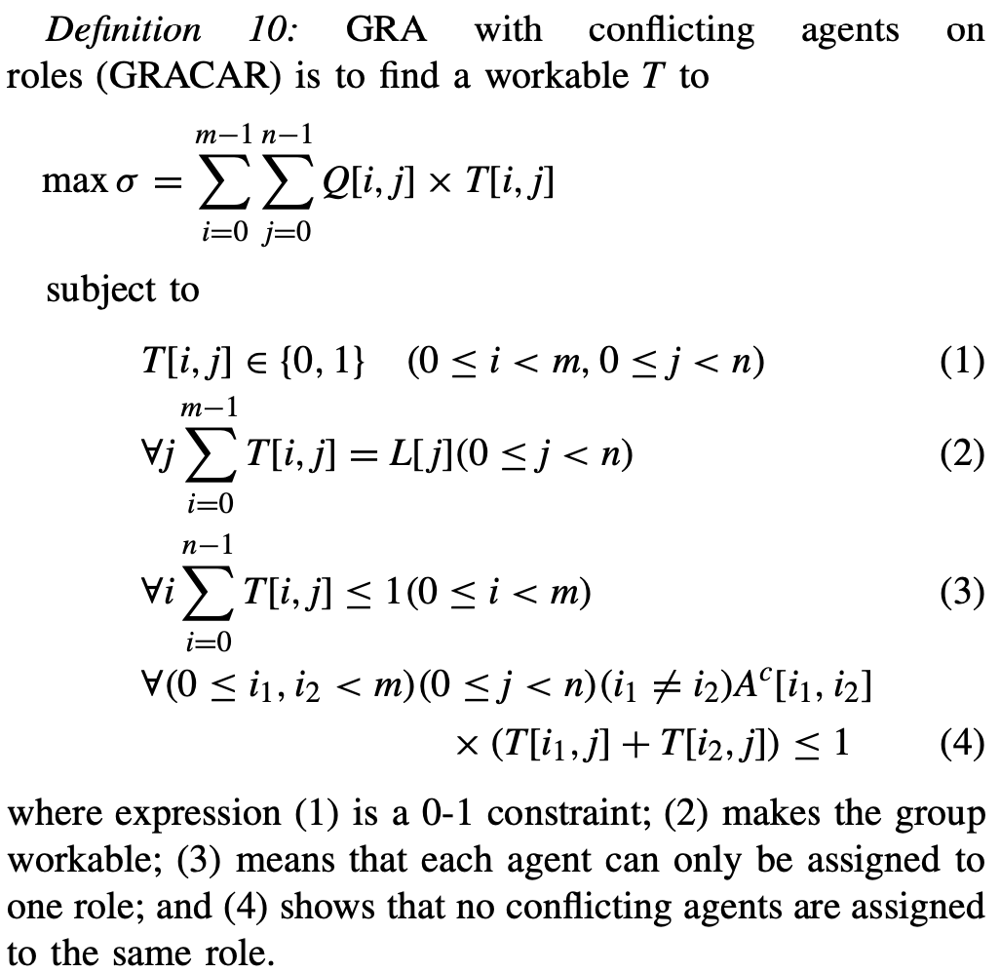
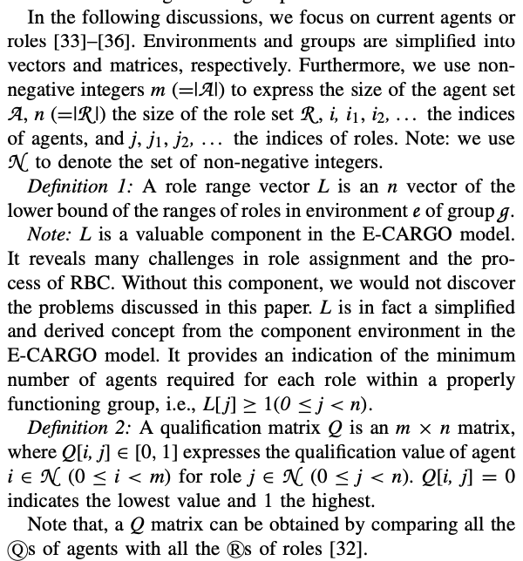
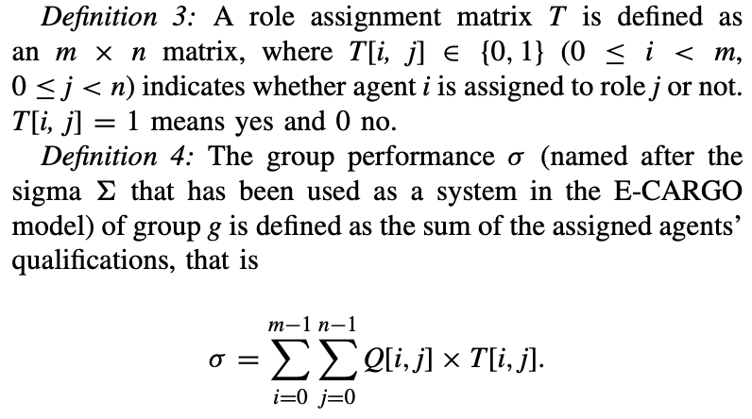
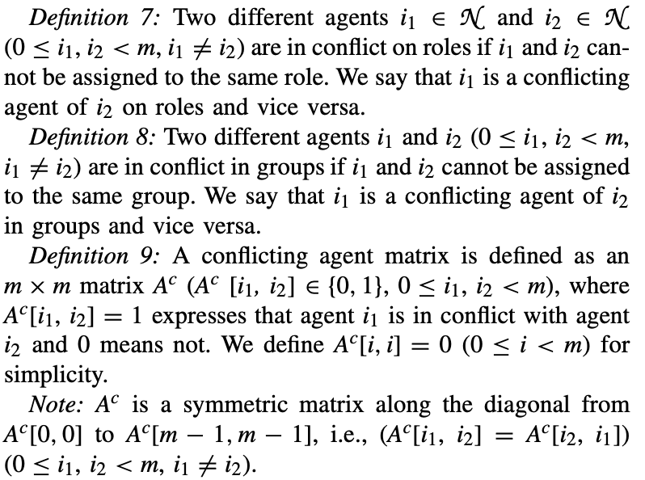
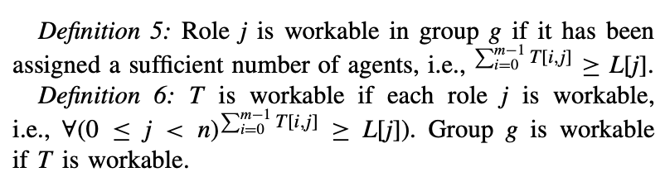
Preliminary Knowledge-GRACAR Model
∑ ::= <C, O, A, M, R, E, G, s₀, H>
Environments
Classes
Agents
Roles
Groups
Objects
Object-based
Agent-based
Role-based
Notes:
Same as the GRA model, we also mathematically formalize the GMRA model. Definitions 1-6 is the same as the GRA model and GMRA model. The biggest difference between GRACAR model and the GRA model is introducing the new Definitions 7-9. Definitions 7 and 8 specify the indexes of two conflicted agents. Definition 9 is the Ac matrix, which is utilized the conflicted relationships among agents. It is a symmetric matrix.
Based on above analysis, the mathematical expression of the GRACAR model is illustrated as Definition 10.

Slide 7
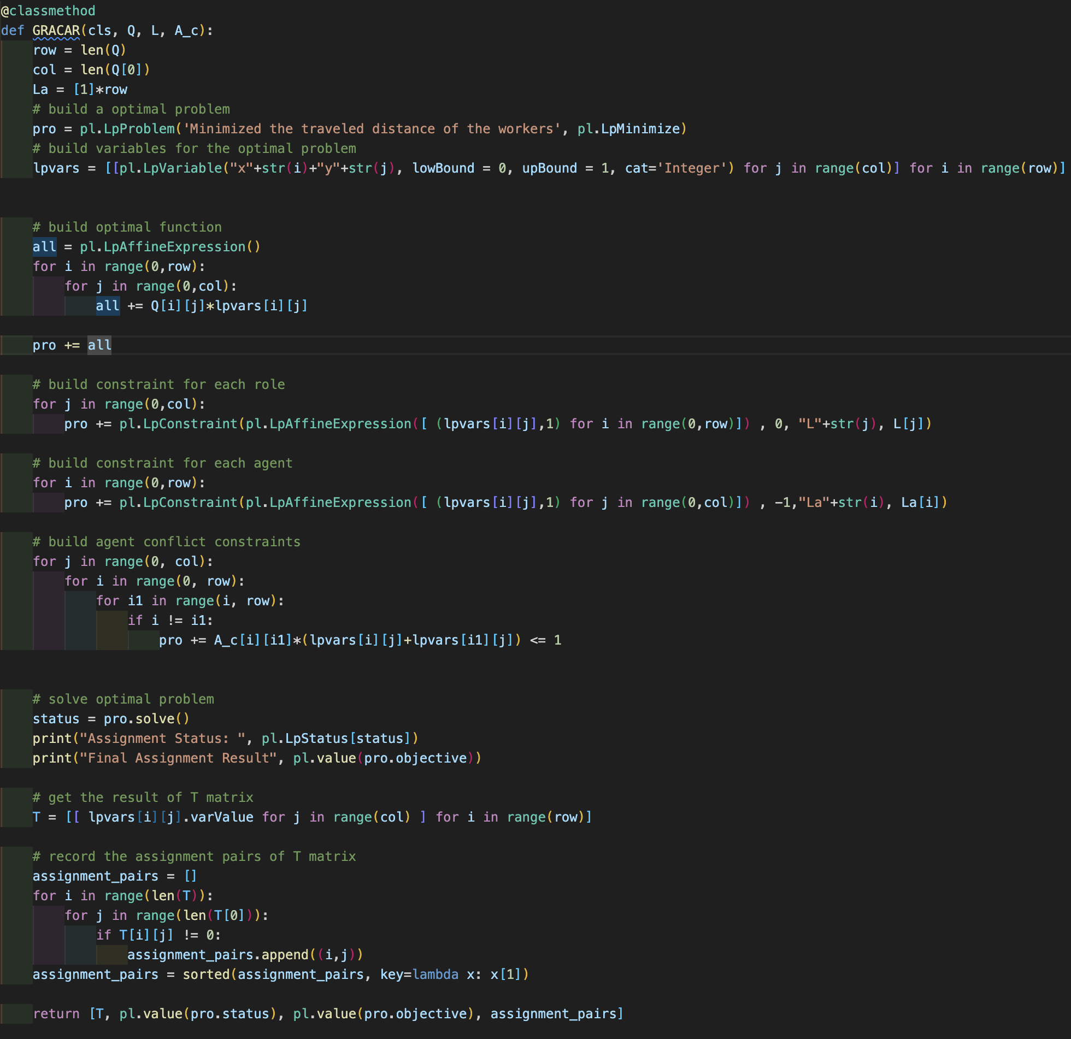
Preliminary Knowledge-Python Code Presentation

Slide 8
Content
Preliminary Knowledge
Objectives
Assignment
Turn in Requirement
Notes:
This lab lesson is divided into five parts. First, we will introduce some preliminary knowledge about Group Role Assignment or the relevant programming information to solve this model. Next, we will talk about the objectives for this lesson. Then, we will talk about the assignment for this lesson and its requirement. (Next slide)

Slide 9
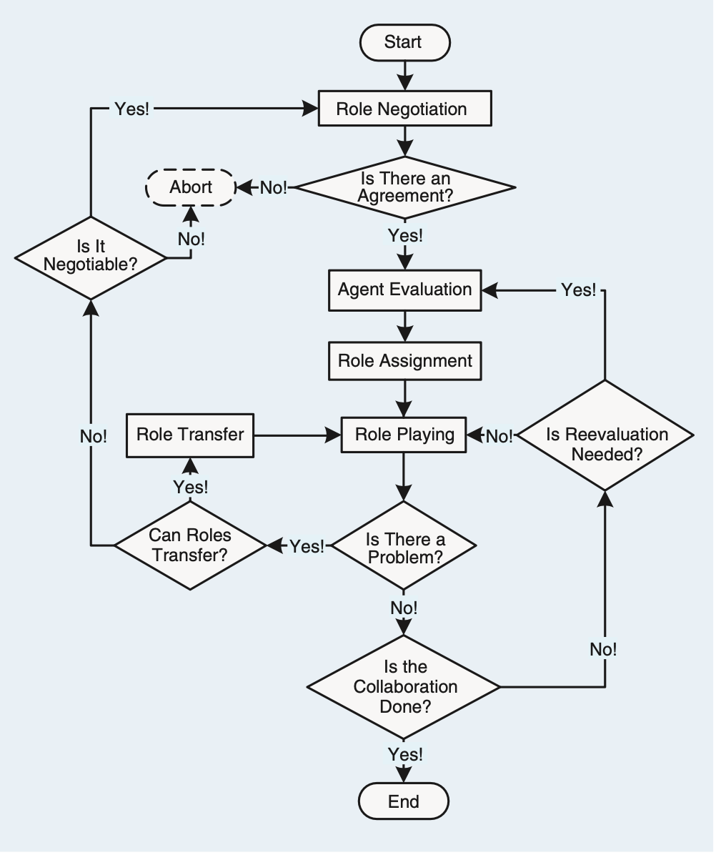
Objectives
The objectives of this course are two-fold:
1. To understand the process of RBC and learn about how to formalize problems with the GRACAR submodel;
2. To practice using Python to program the GRACAR model.
Notes:
The objectives of this course are two-fold:
1. To understand the process of RBC and learn about how to formalize problems with the GMRA submodel;
2. To practice using Python to program the GMRA model in order to solve the M-M assignment problem.

Slide 10
Content
Preliminary Knowledge
Objectives
Assignment
Turn in Requirement
Notes:
This lab lesson is divided into five parts. First, we will introduce some preliminary knowledge about Group Role Assignment or the relevant programming information to solve this model. Next, we will talk about the objectives for this lesson. Then, we will talk about the assignment for this lesson and its requirement. (Next slide)

Slide 11
Assignment
The assignment requirements for this lesson are as follows:
1. Suppose you are a manager of a company. Imagine and describe a scenario, i.e., to accomplish a complex task (RBC) by managing 30 agents (people, equipment, robots, groups of people, etc.). In addition to the scenario required for the first lesson assignment, add a constraint that agents may have conflicting relationships while performing the same role. Please utilize the A^{C} matrix to represent the conflicted relationship when agents perform roles.
2. You need to divide the complex into smaller subtasks (Roles). Be creative, and any simple method can be used.
3. You can choose from a list of candidates (Agents) to join the team to accomplish the task. Be creative, and any simple method can be used.
4. You need to determine a list of requirements for each task (role), i.e., role specification including L and other required properties. Be creative and reasonable. Any simple method can be used.

Slide 12
Assignment
5. Suppose that every agent should have a list of qualifications corresponding to the roles’ requirements. You create the evaluation of each agent for each subtask (role), i.e., the Q matrix. Be creative, and any simple method can be used.
6. After you obtain the Q matrix, use the GRACAR program to get the optimal assignment result, i.e., T.
7. Analyze whether the assignment is good or not from your own personal perspective. Argue why an optimized assignment result may not be the best choice.
8. Consider whether there are scalable aspects in this scenario (i.e., future works), as this is relevant to future lessons.
9. Encode and calculate assignment results using Python’s PuLP, and present the mathematical model and corresponding assignment results in the format of an IEEE paper.
10. If possible, please choose to expand the self-defined scenario from the first lesson, to make the background of the problem you are researching more generic.

Slide 13
Content
Preliminary Knowledge
Objectives
Assignment
Turn in Requirement
Notes:
This lab lesson is divided into five parts. First, we will introduce some preliminary knowledge about Group Role Assignment or the relevant programming information to solve this model. Next, we will talk about the objectives for this lesson. Then, we will talk about the assignment for this lesson and its requirement. (Next slide)

Slide 14
Turn in Requirement
1. A project report including the descriptions of your process details.
2. The report should be in the IEEE conference paper format, page limit = 2~3 pages. Refer to: https://www.ieee.org/conferences/publishing/templates.html, Choose Microsoft Word and US letter.
3. (*Vital) The paper to be submitted should include a depiction of plausible scenarios, modeling, and a reasonable interpretation of the experimental results. Furthermore, providing the source code, inclusive of the data, for the experiments could facilitate a more comprehensive evaluation.
Download the Relevant Materials:
https://github.com/jiangqian1997/E-CARGO-Codes/tree/main/Summber_School_Laboratory/Lab_3

